Slide 1
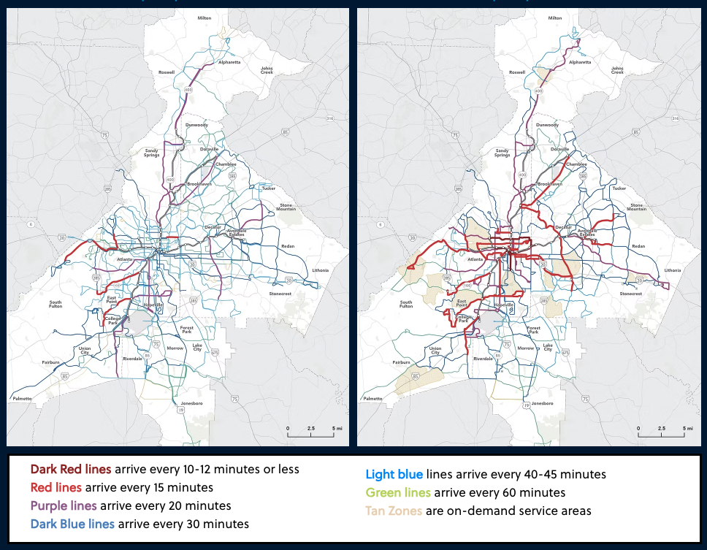
Fall 2023
Network
ProposedNetwork

